Slide 1



Encoding
Some Message
Some
Message
0
1

Slide 2

What is Encoding ?
Encoding categorical data is a process of converting categorical data into integer format so that the data with converted categorical values can be provided to the models to give and improve the predictions.

Slide 3
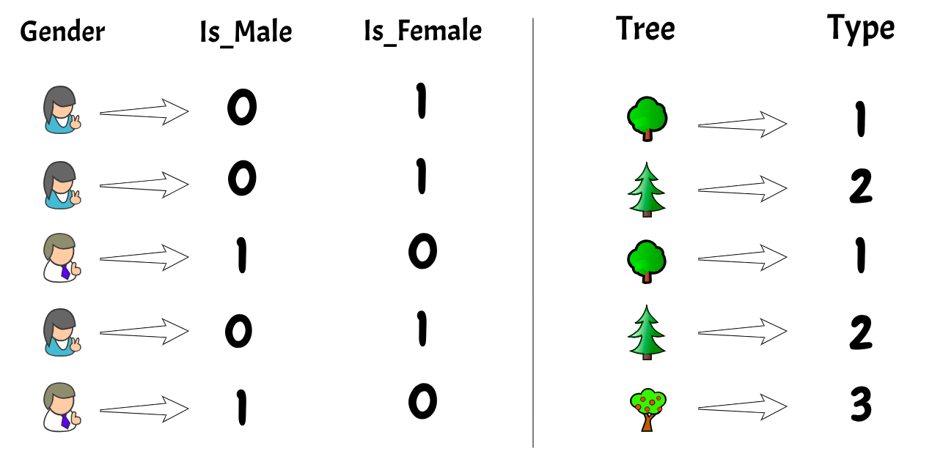

Slide 4
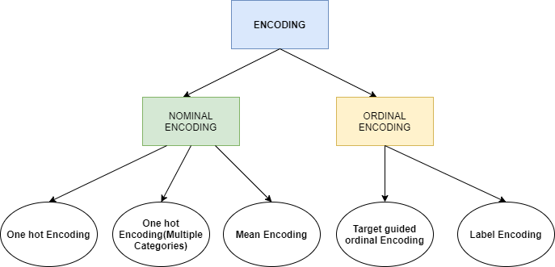

Slide 5
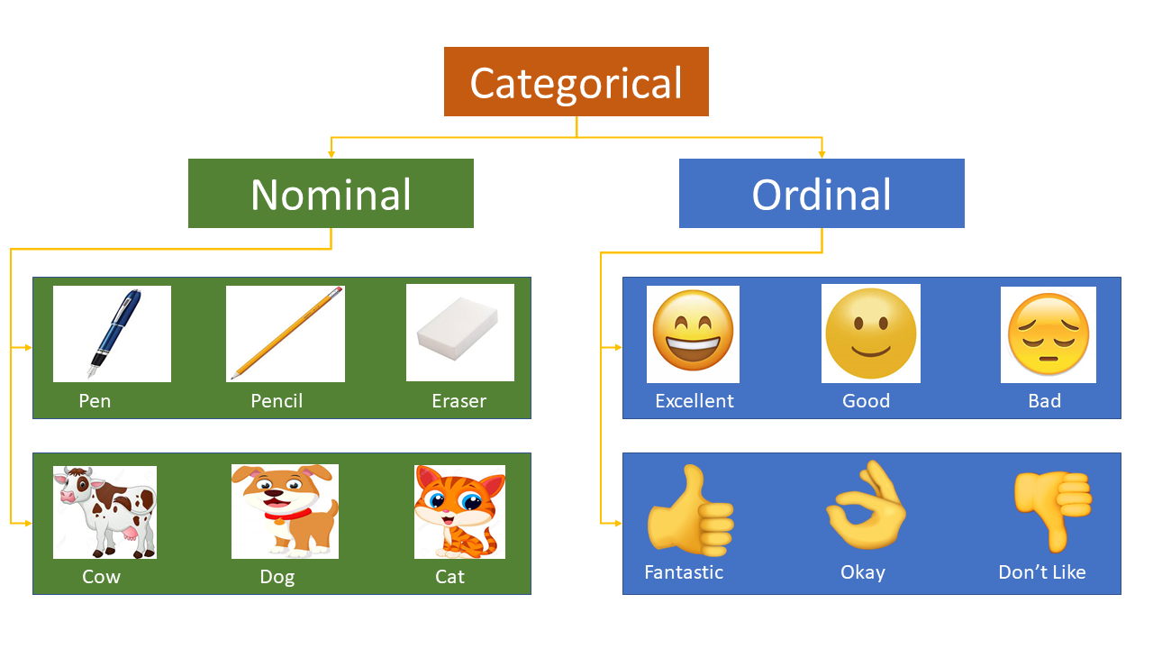

Slide 6


Slide 7


Slide 8
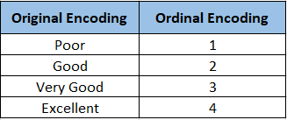
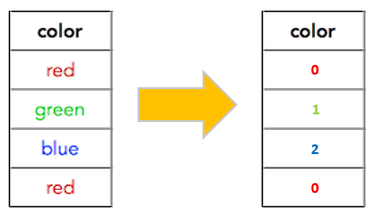
Label Encoding
or
Ordinal Encoding
Nominal Encoding
This type of encoding is used when the variables in the data are ordinal, ordinal encoding converts each label into integer values and the encoded data represents the sequence of labels.
All the variables in the respective feature are equal. We can't give them any orders or ranks. Those features are called Nominal features.

Slide 9

Different Types
One-Hot Encoding
Effect Encoding
Binary Encoding
Base-N Encoding
Hash Encoding
Target Encoding

Slide 10
Let’s Code in Jupyter Notebook
With The Help of
“Sklearn-Scikit-Learn”

